Slide 1
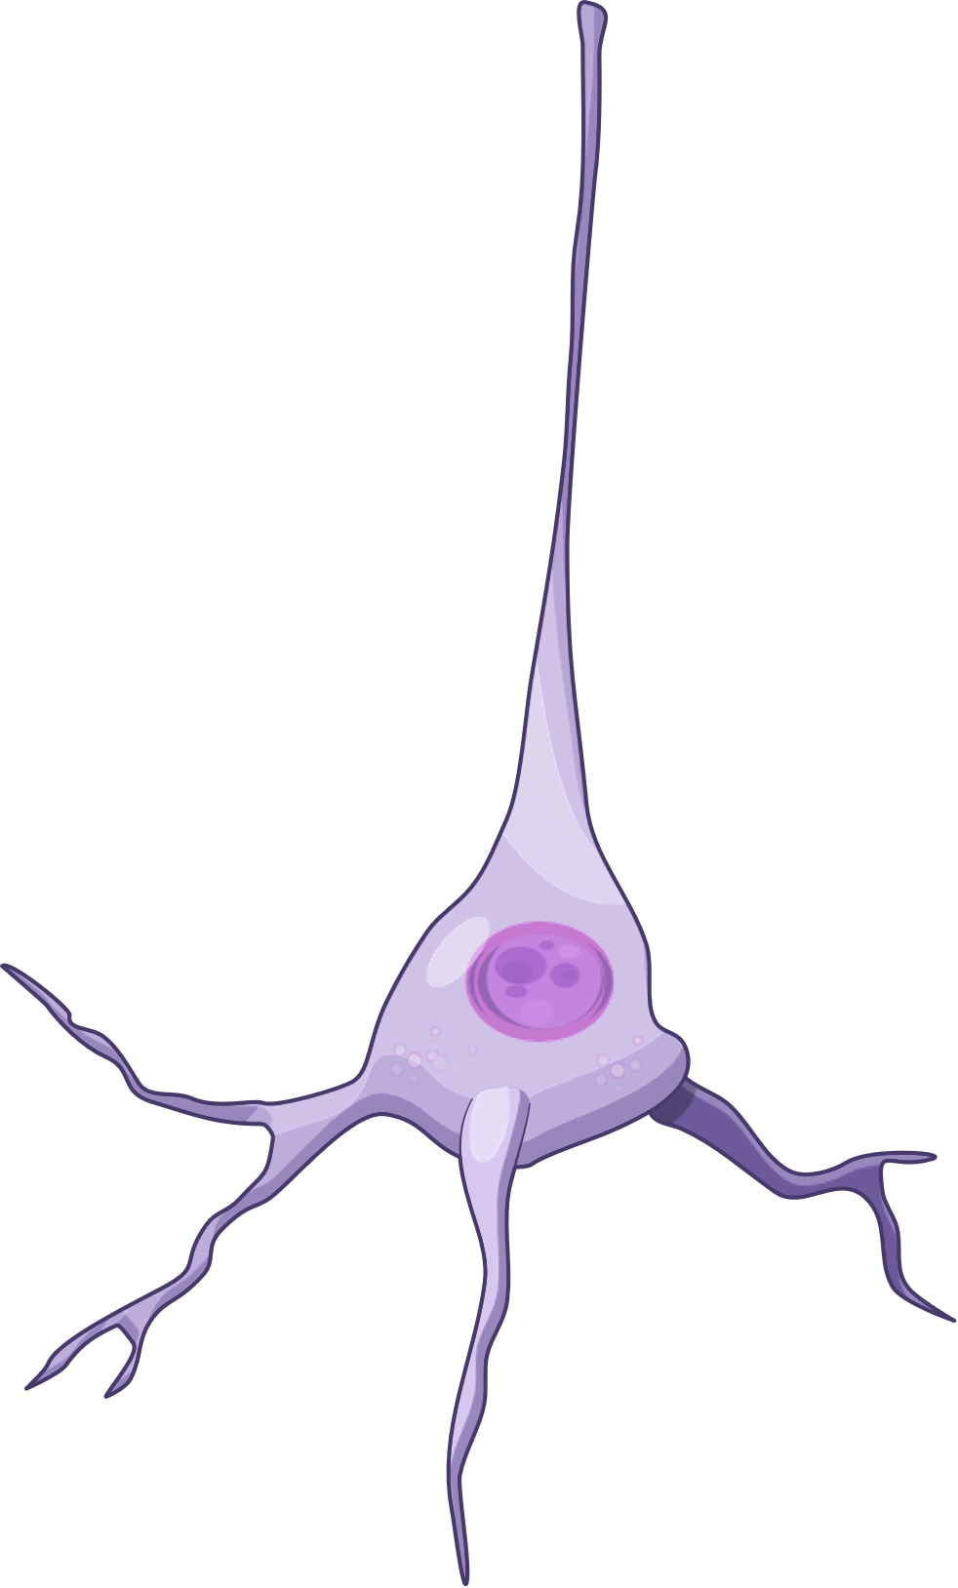


Collect your package
Coming
Coming
Brother! you are here too
Just here to help you carry this
CA1
Same same but different
Such a nice neuron
Type A
Pyramidal neuron
Type B
Pyramidal neuron
Type A

